Slide 1

Order Management through Mobile Apps.
Mockup User Requirement Specification (URS)

Slide 2
Use Case Description
Use Case ID: Date:27-12-2015
Use Case Name: TBL- Order & Market Return Management Version: 1.2
Primary Actor (s) : PSR Secondary Actor (s) : DBH Operator
PSR will collect the order according to route plan but sequential visit is not mandatory.
Firstly, PSR will enter in route, then sub-route. After entering in sub-route, they will get available(target) outlets for particular days. Meanwhile, they will get a summary where target outlet, success, not order, Pending, LPC & Strike Rate related information be available and gradually update according outlet visit.
Secondly, PSR select particular outlet when they physically visit outlet. When select outlet, PSR will get a “Distance Measure” pop-up and alert him/her about the physical distance between outlet and PSR standing.
Then after, PSR will view outlet & owner information, last 3 order and due information. If outlet place no order or close, then PSR will click on exception and select exception reason for not taking order.
Thirdly, in order to take order PSR will click on order menu and add order by select brand and SKU. At the time of order taking, PSR will input case & PCs as SKU quantities and then, system will automatically the total value. Afterward, PSR will add these quantity, which will show in Order Summary (Memo). In order summary, PSR will also edit or discard SKU quantity.
Fourthly, PSR will also take market return like order collection by selecting return criteria from particular outlet.
Finally, PSR will view final order summary and save this order for particular outlet.

Slide 3
Mobile Order Taking Workflow

Slide 4
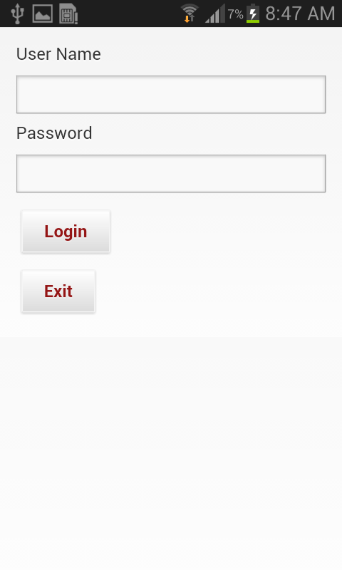
Login User Interface
To login into the system Internet connection must be there.
User need to give their individual User Name & Password to login into the APK system.

Slide 5
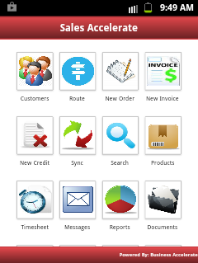
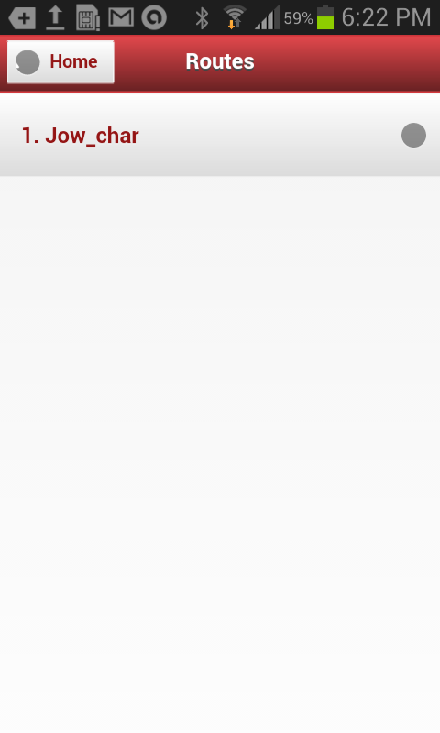
User View after Login
User need to click the “Route option” to know about the pre-defined route – Figure 1
After clicking the “Route” user can see the Route Plan – Figure 2
Figure 1
Figure 2

Slide 6
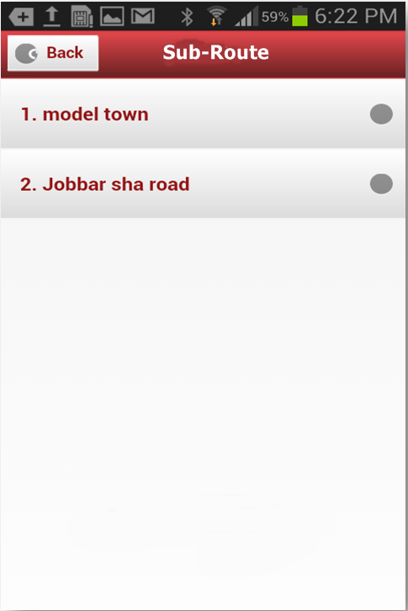
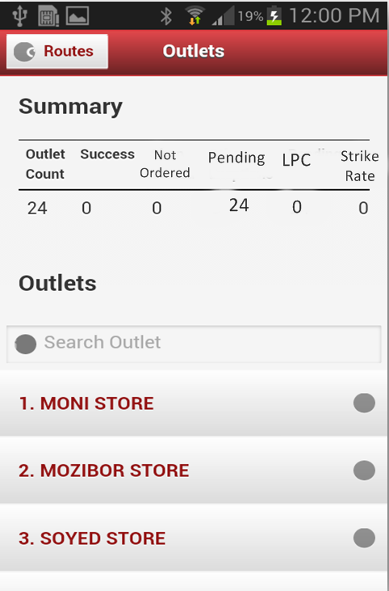
Sub-route & Outlet
Here user can see the list of sub-route of that route
By clicking in the individual sub-route, user can also see the number of outlets of that individual market.

Slide 7
Outlet Selection & Order Creation
Selecting the outlet name user can create order for that individual outlet.

Slide 8
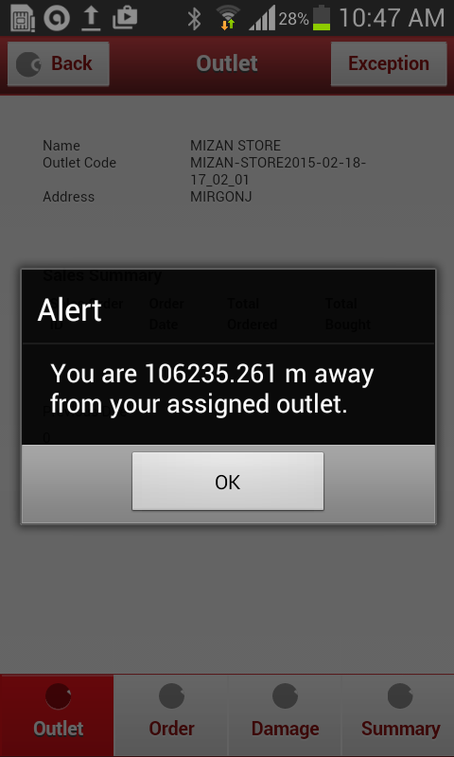
Distance Measure
While PSR will select the outlet, system will show an alert message.
In the alert message the distance between the user and the selected outlet will be automatically shown by the system.

Slide 9
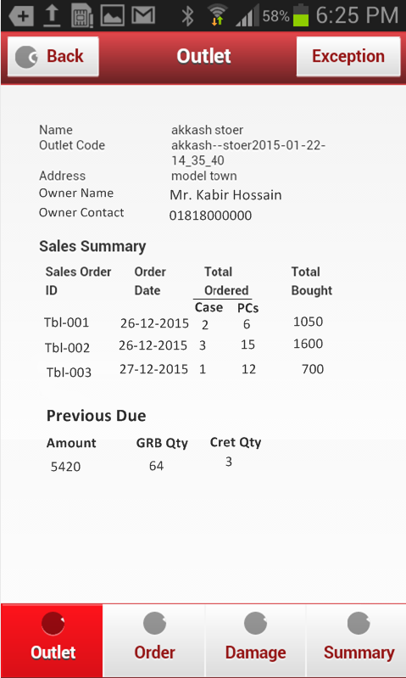
Outlet Details
To create sales order user need to click on the “Order” button.
If the PSR fails to take any order from the selected outlet, S/he will select the Exception reason . The exception reasons will be pre-defined in the system.

Slide 10
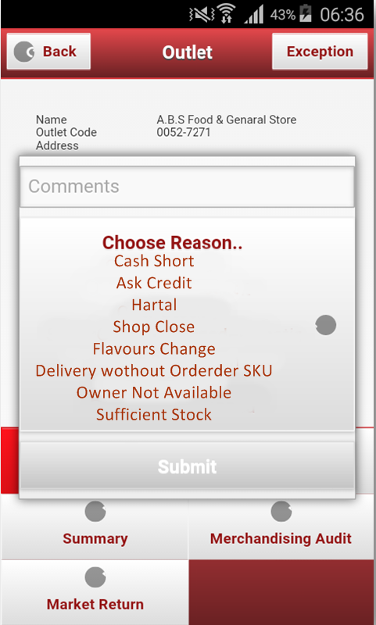
Exception Reasons
Here, PSR select exception reasons for not taking order and then after, submit.

Slide 11
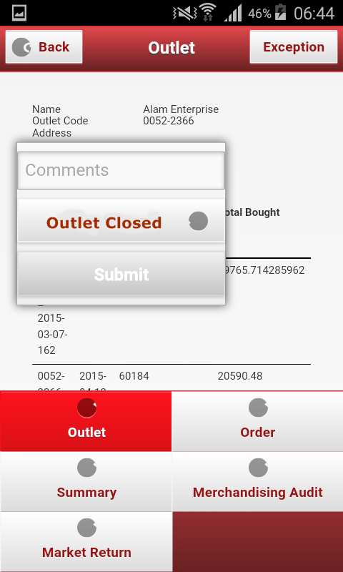
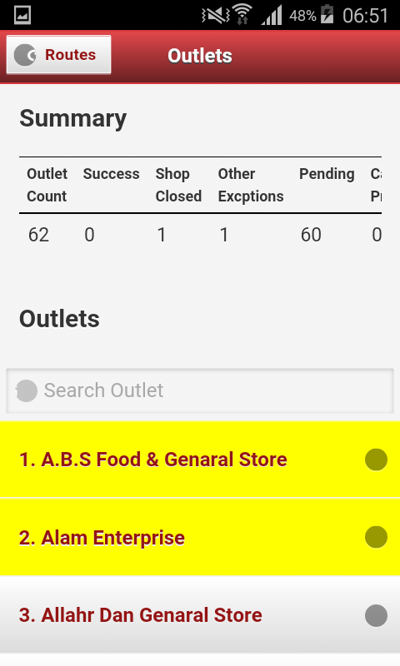

Submitting Exception Reasons UX
Figure 1 shows PSR submit exception reason.
Figure 2 shows colored non-taking order outlets
2
22
Color Meaning in figure 2-
Yellow- Not Ordered
Green – Ordered
Blank- Pending Order
Figure 1
Figure 2

Slide 12
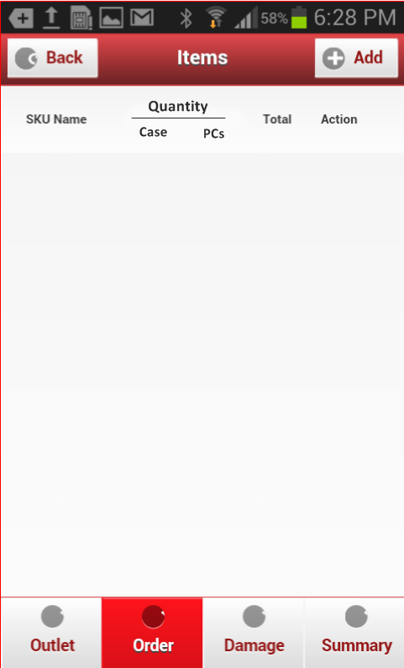
Order Taking
After clicking the “Order “ button this view will be opened and the user can create order by clicking the “Add” Button.

Slide 13
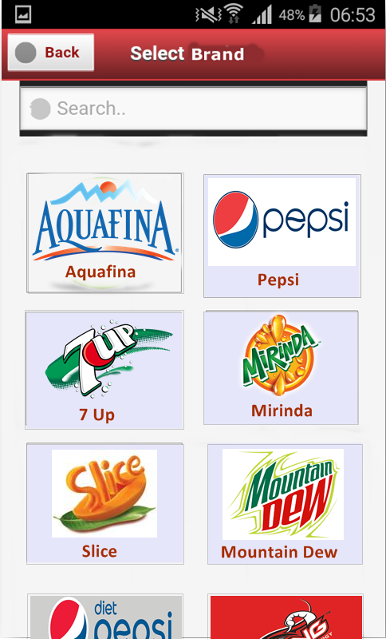
Select Brand
To make an order PSR need to click on the Brand that is ordered by Outlet.
After clicking on the Brand, PSR will see the product list.

Slide 14
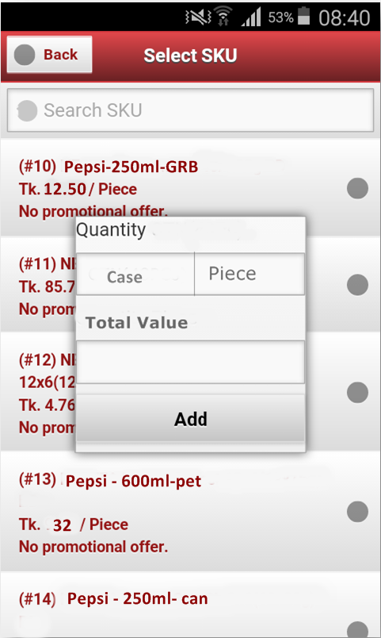
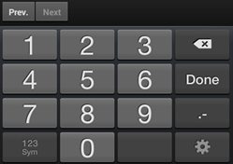
Selection of Product & Qty.
When the PSR will press the Add option the list of SKU’s will be shown. The PSR can also search any SKU from the search option.
The promotion offer will be shown under the individual product in color.
While PSR will select any individual SKU, the Add option will be viewed & in the add option, S/he will only input quantity as Case & Piece wise. After providing quantity input, total value will automatically calculate and show.

Slide 15
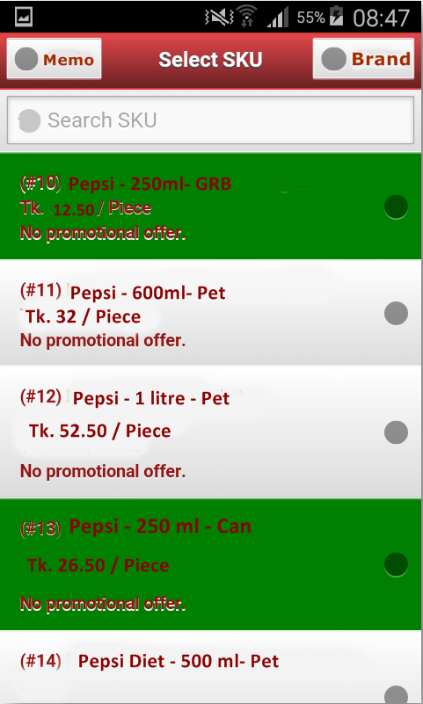
View after Order Confirmation
The selected product will turn into a Specific color.
PSR can select multiple product by clicking on Brand.
To see the ordered product details, DSR need to press the “Memo” Button

Slide 16
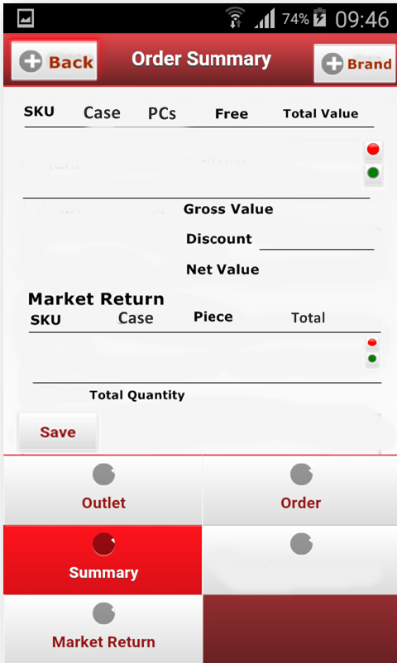
Ordered Product Details - Memo
By clicking the “Red Button” the user can cancel the order of specific SKU and by clicking the “Green Button” the user can Edit or Change the Quantity of Specific SKU.

Slide 17
Market Return Workflow

Slide 18
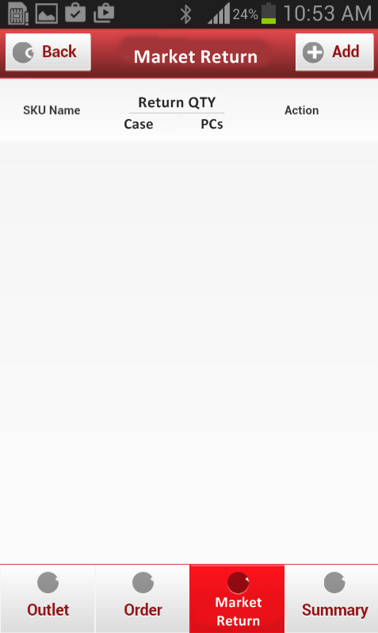
Market Return
Add the market return product from here like order taking process.

Slide 19
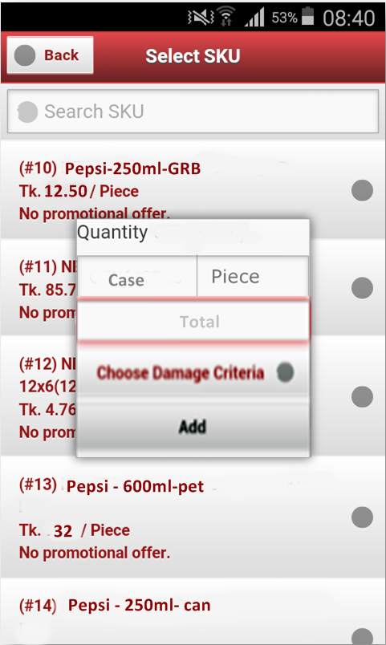
Add Return SKU & Criteria
When PSR selects the Specific SKU the Add Option will be shown, where the user will select the Damage Criteria

Slide 20
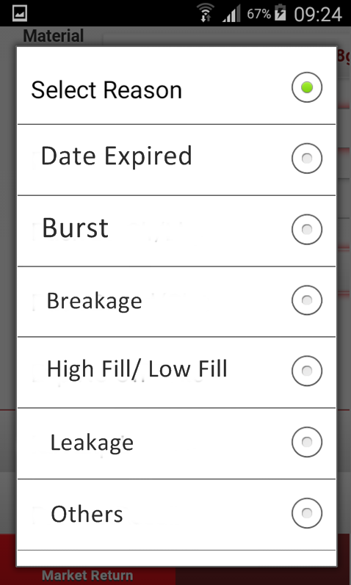
Select Return Criteria
To choose the damaged criteria click on “Choose Damage Criteria” button, a list of damaged criteria will be shown bellow. It will be predefined.

Slide 21
Market Return - Memo
By clicking the “Red Button” the PSR can cancel the order of specific SKU and by clicking the “Green Button” the PSR can Edit or Change the Quantity of Specific SKU.

Slide 22
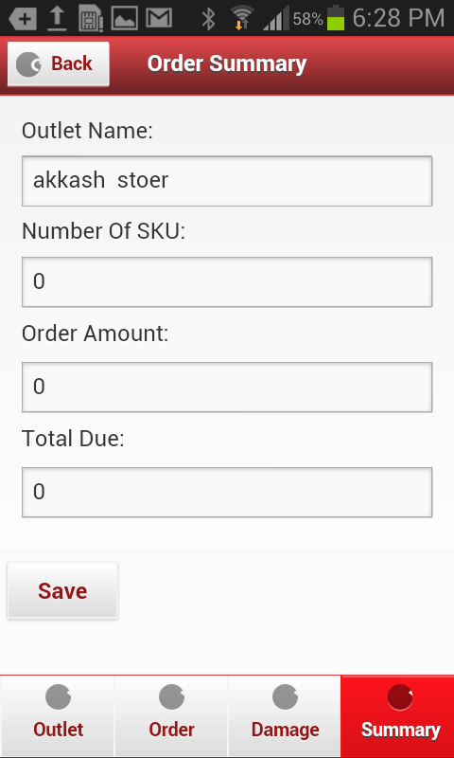
Order Summary
Outlet Name
No. of SKU
Order Amount
Total Due
Damaged SKU
Total Damaged Qty.
This is the Summary Interface.
The Outlet Name, Total No. of SKU , Total Ordered amount and the Total due amount will be shown in the order summary.
Damaged No. of SKU and Quantity of Damaged SKU will be shown in the Damage Summary.
Value
GRB
CRET
Case
PCs
Damage No. of SKU
Quantity of Damaged SKU
Save

Slide 23
Thank You

